Slide 1
Advanced Web Programming
Faculty: Elizabeth George

Slide 2
What This Course Will Cover
The BASICS
Syntax and Semantics
Accessibility
Getting Started
Right down to How to Create a File

Slide 3
Programming Project
You can start working on this from the first day of the class
Design and implementation of a professional website:
Professional Style
You can complete the project in teams of two, at the most three

Slide 4
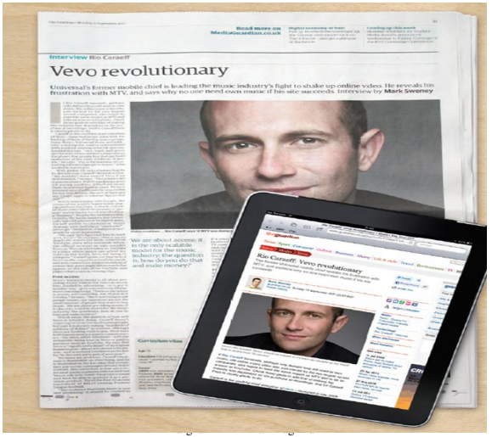
Why do you think Web Programming is important?

Slide 5
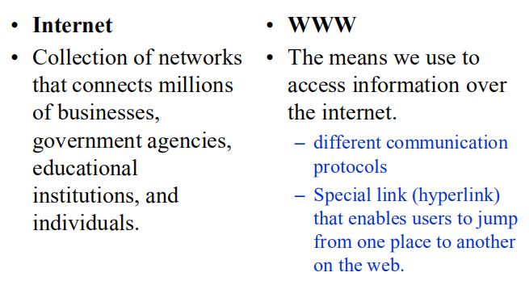
Is www and Internet same?

Slide 6

Wikipedia launched in 2001
MySpace opens in 2003
Facebook February 2004
Notes:
Which of these do you recognize?

Slide 7
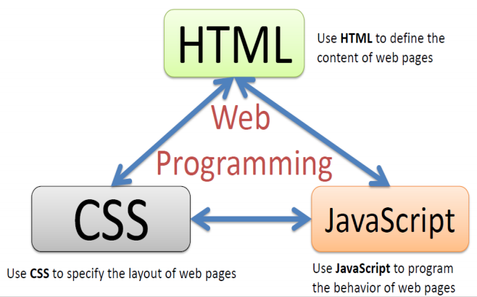
The Web Programming Triangle

Slide 8
HTML5
What it is…and why we aren’t
starting at HTML 1.0

Slide 9
What is HTML?
HTML stands for Hypertext Markup Language

Slide 10
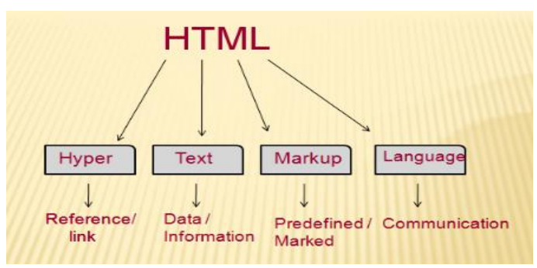
What is HTML?

Slide 11
“Learning” HTML
In the beginning you worry about syntax
What tags are there?
Did I remember to “end” my tag?
Later, you will worry about semanticsne is searching my page can they find what they need and access it easily?

Slide 12

Early Years
HTML (1) was created in 1990 as a way to electronically connect documents via hyperlinks (hence a “web” of connections)

Slide 13
Mosaic
In 1993, Mosaic emerged as the first graphical browser.
WWW grows at a 341,634% annual growth rate of service traffic
Mosiac had challengers though in the form of Netscape (1994), Internet Explorer (1995) and others.

Slide 14
The Browser Wars
Browsers had proprietary tags
<marquee>...</marquee> (scrolling text)
<blink>...</blink> (blinking text).
Other tags that went against the spirit of the original tenets of HTML were added, e.g. <font>, <center>, and <bgcolor>
Origination of “Best viewed on” messages.

Slide 15
Web Standards
No one “runs” the Internet or the Web, some groups do take proactive roles:
Internet Engineering Task Force (IETF)
World Wide Web Consortium (W3C)
The Web Accessibility Initiative (WAI)

Slide 16
Evolution of Browsers
1990 – 1994 | HTML was simple, content was primarily text-based
1993 | Mosaic enters the scene with images and … BOOM!!!
1995 – 1999 | Cross-browser compatibility falls apart
2000 – 2005 | Browsers move toward separating content from style.
2005 – 2008 | Using HTML files in coordination with CSS becomes new standard.

Slide 17
Evolution of HTML
1993 | HTML 1.0 - Developed by Tim Berners-Lee to link document
1995 | HTML 2.0 - Developed by Internet Engineering Task Force RFC to include stylized text and tables
1996 | CSS 1
1997 | HTML 3.2 – Developed by W3C and included browser specific features
1997 | HTML 4.0 – A move back to normalizing the pages across platforms.
1998 | CSS 2
1999 | HTML 4.01 – Introduced different document types
2012 | HTML 5 - Back to HTML plus multimedia and semantic tags

Slide 18
The Request/Response Cycle
Or, what happens when you type something into the address bar

Slide 19
How Does This All Work?
When you type an address into the URL bar, what happens?

Slide 20


Networks
z
The Internet
LAN
WAN
WAN
LAN

Slide 21
Client/Server Relationship
Servers
Machines that hold shared resources
Always connected to the network
Clients
Machines for personal use (laptops, phones, etc.)

Slide 22
Request/Response Cycle
This is what happens when your computer (the client) requests a page and a server responds with the appropriate files.

Slide 23
Uniform Resource Locator
URL – three parts:
1. protocol – how to connect
2. domain – where to find the document you want
3. document – what specific file is needed*
Most pages are made up of multiple files

Slide 24
1. Protocols
HTTP – Hypertext Transfer Protocol
HTTPS – Secure Hypertext
Transfer Protocol
FTP – File Transfer Protocol

Slide 25
2. Domain Names
Identifies the entity you want to connect to
umich.edu, google.com, wikipedia.org
Each has different top-level domain
Determined by Internet Corporation for Assigned Names and Numbers (ICAAN)
https://www.icann.org/resources/pages/tlds-2012-02-25-en

Slide 26
IP Addresses and the Domain Name Server (DNS)
Internet Protocol Version 4 (Ipv4) uses number format of xxx.xxx.xxx.xxx to identify each domain
can represent over 4 billion unique combinations (2³²)!
DNS looks up the domain and returns the IP address

Slide 27
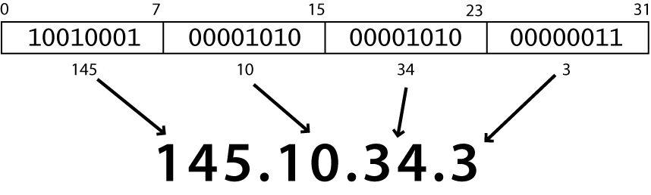
Internet Protocol (IP)
Simple protocol for data exchange between computers
IP Addresses:
32-bit for IPv5
128-bit for IPv6
Notes:
find out your internet IP address: whatismyip.com find out your local IP address: in a terminal, type: ipconfig (Windows) or ifconfig (Mac/Linux
Routers forward data based on tables
IP is simple: no corruption check, no sequencing, no data loss assurance, no duplication

Slide 28
Domain Name Service (DNS)
cs.biu.ac.il www.netscape.com www.cmu.edu
Map Domain Name to IP Address
Domain Names must be Unique
Domain Names have many Parts
Suffix of Domain Names Significant

Slide 29
Domain Names
cs.biu.ac.il
il
ac
biu
tau
cs

Slide 30
DNS - Domain Name Lookup
Search in cache
Search in local repository
If the name is in the same domain
If the name was retrieved lately
Ask other servers

Slide 31
DNS - Domain Name Lookup
Domain name
server
in Israel
User’s computer
in Israel
User’s computer
in USA
Name
Internet
IP Address

Slide 32
DNS - Domain Name Lookup
Domain name
server
in Israel
Domain name
server
in USA
User’s computer
in Israel
Name
User’s computer
in USA
Name
Internet
IP Address
IP Address

Slide 33
3. Document (optional)
URLs can specify a specific document
http://www.intro-webdesign.com/contact.html
http://www.intro-webdesign.com/Ashtabula/harbor.html
If no document is specified, the default document is returned.
Convention is index.html

Slide 34
The Request
Once the IP address is determined, the browser creates an HTTP request.
Lots of hidden information in this request
header, cookies, form data, etc

Slide 35
The Response
The server returns files, not “web pages”
It is up to the browser to decide what to do with those files
If the server can’t fulfill the request it will send back files with error codes: 404, 500, etc.

Slide 36
Status Codes
HTTP status lines contain both a numeric status code and a text reason phrase
HTTP/1.1 200 OK Status line
Status Code Response phrase

Slide 37
HTTP Status Codes (contd)
The general form of an HTTP status code is “xyy”, where the first digit, “x”, is specified as
Status Codes Format | Meaning
1yy | Informational Message
2yy | Success
3yy | Redirection
4yy | Client Error
5yy | Server Error

Slide 38
HTTP Error Codes
When something goes wrong, the web server returns a special "error code" number
Common error codes:
Number | Meaning
200 | OK
301-303 | page has moved (permanently or temporarily)
403 | you are forbidden to access this page
404 | page not found
500 | internal server error

Slide 39
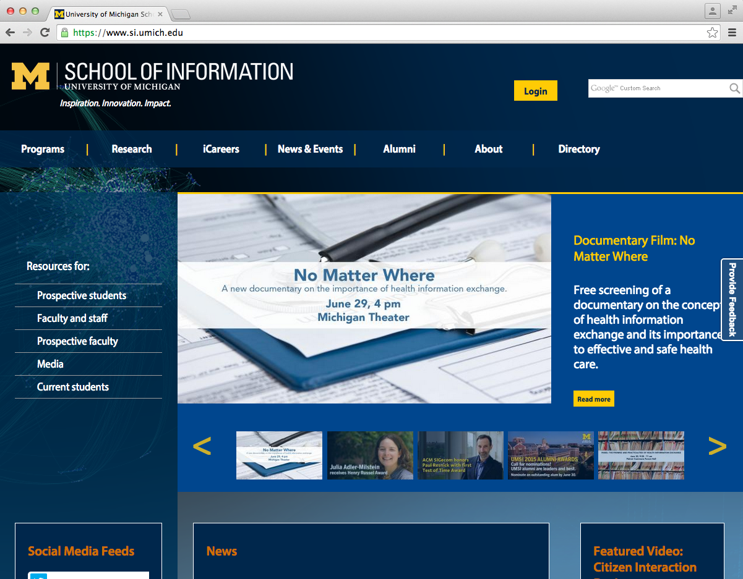
What happens when you type “http://si.umich.edu/” into the address bar.
1. The browser look up the domain in the DNS
The Request/Response Cycle is initiated
2. The DNS returns the IP address:54.88.175.189
3. The browser sends an HTTP request to the server located at that address.
4. The server finds the requested file and sends it back as a response.
5. The browser takes the response and renders the HTML code as a nice graphical presentation, often repeating steps 3 – 4 as needed to request images and other supporting files.

Slide 40
Original | Country | Generic
.org | .au | .airforce
.net | .br | .biz
.int | .de | .community
.edu | .ie | .jobs
.gov | .uk | .travel
.arpa | .us | .wiki

Slide 41
Review
A URL has three parts.
Request/Response cycle typically requires multiple rounds of communication between the client and server.

Slide 42
Tags to practise
HTML
HEAD
TITLE
BODY
PRE
MARQUEE
H1
H2
H3
H4
H5
H6
BR
P
Always begin with <!DOCTYPE html>

Slide 43
Thank you!

